Slide 1
PI-21 Update on bulk
Paul Baker, Sri Miriyala

Slide 2
Workstream Update
Workstream Name: | Rest of bulk
Roadmap Pillar: | Achieve Scale
Lead: | Paul Baker
Workstream Objectives: | Deploy a PoC - test the MVP Identify MVP extensions/modifications based on PoC experience. Complete the development of bulk at the Payee end, to support the breakdown of bulk transfers in to single transactions with the Payee CBS. Support adopters
Progress Against Objectives: | Objectives 1 Payment Manager support for Payer bulk enhancements Infrastructure as code (IaC) has bulk built-in Payment Manager Helm using latest SDK Scheme Adapter IaC deploy Payment managers that support bulk enhancements Bulk deployment tests and external bulk deployment test have been added to the IaC testing pipeline
Issues: | Development teams have been distract on other projects. Hard for others to adopt without the IaC integration updates.
Next PI: | Objectives 2, 3 & 4, Bulk Patch notification; CCB workshop

Slide 3






Why is the bulk use-case important?
→ Pillar 2 Support; adding new use case to achieve scale.
Salary payments
Social disbursements
mojaloop
Make Adoption Easier
Achieve Scale
Connect to Other Systems
Quality Product

Slide 4
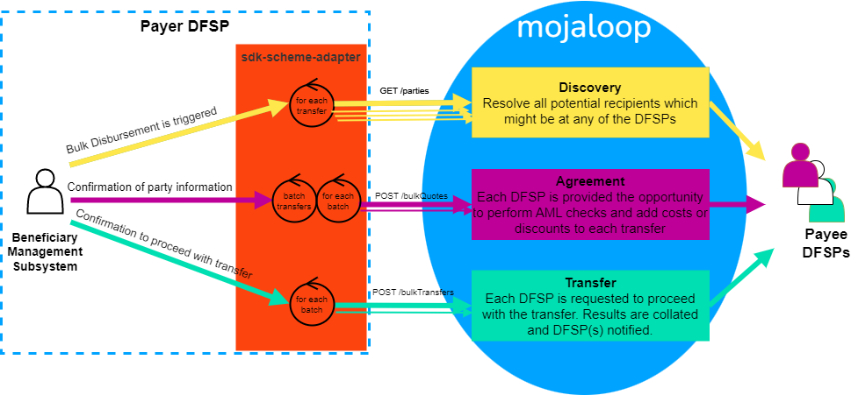
Bulk use case in Mojaloop

Slide 5

Non-repudiation in bulk
JWS
Bulk Quote Message
Payee DFSP
Payer DFSP
m
JWS
Bulk Quote Message
JWS
Bulk Quote Message
ILP
→ Releases funds
→ Takes on risk
Bulk quotes
→ Message cannot change at the hub
→ Must be signed by Payer DFSP
→ Must be able to trust message
→ Verify message origin (JWS)
More to discuss / workshop here.

Slide 6
Demo
Demo recording link: https://drive.google.com/file/d/1PYuDUNOyr62XLgduTEZGFqcYDQOU5IrL/view?usp=sharing

Slide 7
Contributors
Kevin Leyow
Miguel de Barros
Paul Baker
Sam Kummary
Sridevi Miriyala
Vijay Kumar

Slide 8
Mojaloop Bulk Feature Roadmap
Mojaloop Hub
DFSP Connection Support
Integration Support
FSPIOP
UI support
Payer DFSP Enhancements
Payee DFSP Enhancements
UI support
STD Core Connectors
bulkQuotes
bulkTransfers
Enhanced Tests - Improved test coverage
IaC Integration testing
Asynchronous
>1000 transactions
Discovery
Multi - Payee DFSP
Persistence
Scalable
Robust (failure design)
SDK support for bulk Quotes
SDK Support for bulk Transfers
/bulkTransactions API Published
Bulk Integration patterns are documented
Current features
Enable reserve - commit integrations (Bulk Patch Notification)
Bulk Discovery
Performance of switch with Bulk
PISP Bulk
Bulk Transfer Dashboard (micro-frontend)
Synchronous
Auto accept party
Auto-accept quote (with fee limits per currency)
Only Validate Party
Skip Party lookup
Bulk Expiration
Demultiplexing for bulk Quotes
Demultiplexing for bulk Transfers
Payment Manager Support
Payer Bulk Transfer Dashboard
Hackathon
Bulk Mojaloop Training Program new course and course extensions
Backlog features
Supporting Bulk at Hub
Supporting Bulk at DFSP
Supporting Integrations

